Slide 1
ELEMENTARY
Ramkumar Subramanian
Sadhave Subathra Rajasekar
Sreeram Jayaram
Rohit Sarkar

Slide 2
QUESTION 1 TIME SPENDING PATTERN Summary in 2012 Time Spent in a day
Most of the time spent on
Sleeping
Socializing
Television
Notes:
Others include Housework, Grooming, Food & Drink Prep, Caring for Children, Shopping,
Volunteering, Playing with Children, Job Searching, Golfing and Running

Slide 3
QUESTION 2 TIME SPENDING PATTERN Age & Average Time Spent
Adults sleep less compared to the other age group
Time spent on watching television increases as age increases
Young people run more

Slide 4
QUESTION 2 TIME SPENDING PATTERN Summary in 2012 Education & Activity
Time for job search increases as the person gets more education

Slide 5


QUESTION 2 TIME SPENDING PATTERN Summary in 2012 Activity Average Time Spent & Gender
Notes:
Average Time is given in hours

Slide 6





QUESTION 3 BABY CARE % of time spent in a day per child Education & Gender
GENDER
3%
2%
Women spend 74% more time to take care of children than men
EDUCATION
3%
4%
3%
2%
People with an associate degree or who went to college significantly spend more time than every one else
College graduates spend more time than a graduate degree holder
< High School
GED / Voc
College graduate
Masters/ PHD/ Prof Deg
Notes: 95% significance tests
Kruskal Wallis test – more than 2 category non normal variables
Wilcox test – 2 category non normal variables

Slide 7
QUESTION 3 BABY CARE % of time spent in a day per child Working hours & Income
WORKING HOURS
Time spent for child care decreases as the work hour increases
WEEKLY INCOME
No significant difference among categories of weekly income and time spent with children
Notes:
95% significance tests
Kruskal Wallis test – more than 2 category non normal variables

Slide 8
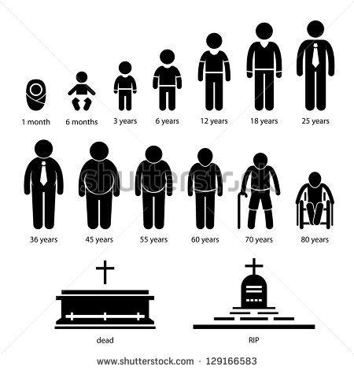

QUESTION 4 LEISURE TIME % of time spent in leisure activities per day Age & Leisure Time
AGE
32%
30%
44%
Middle Aged (25-55 yrs) spend less time for leisure activities compared to other ages
Young
Middle Aged
Old
Notes: 95% significance tests
Kruskal Wallis test – more than 2 category non normal variables
Age is segmented to three equal groups – Young (0-25 yr) ; Middle-aged (25-55 yr) ; Old (55+ yr)

Slide 9

QUESTION 4 LEISURE TIME % of time spent in leisure activities per day Weekly Income
WEEKLY INCOME
As income increases, time spent for leisure activity decreases
Low income
Medium Income
High Income
Notes: 95% significance tests
Kruskal Wallis test – more than 2 category non normal variables
Weekly income categorized to three equal groups using quantiles

Slide 10
QUESTION 5 RECESSION % Employment status across years Employment Status & Year
Unemployment rate increases during recession and is on the rise post recession
Employment rate decreases during and post recession period

Slide 11
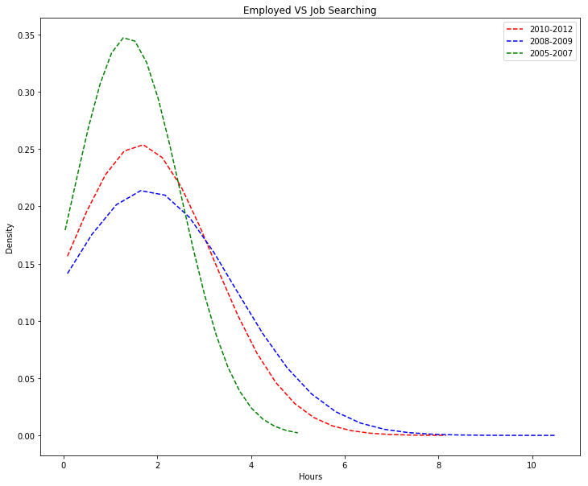
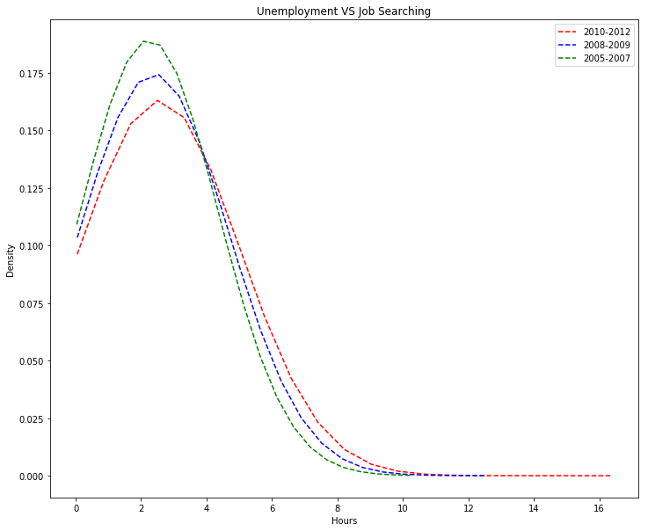
QUESTION 5 RECESSION Density curve Employment Status & Job Search Time
The job search time during recession has increased tremendously compared to the previous years.
The increased job search time has almost remained the same post recession until 2012.
Job search time among the unemployed has slightly increased compared to the pre-recession period.

Slide 12
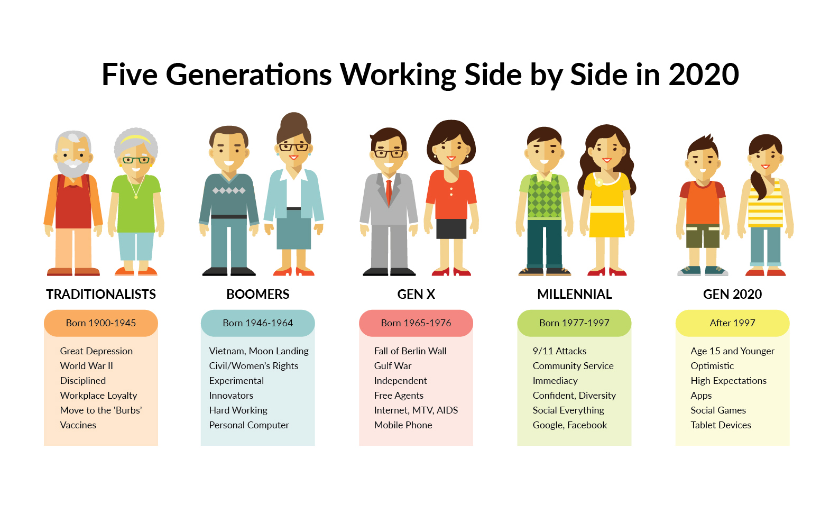

















QUESTION 6 PRIMARY ACTIVITY Primary activity in the age group Age & Leisure Activities
0-19 yrs
20-29 yrs
30-49 yrs
50-69 yrs
70+ yrs
Running
Job Search
Job
Golf
Socializing
Sleeping
Running
Child care
Volunteering
Television
Grooming
Child care
Shopping
Food prep
Volunteering
Notes:
Predominant activity for every age group is categorized and mentioned
Age groups with similar activities are grouped together

Slide 13
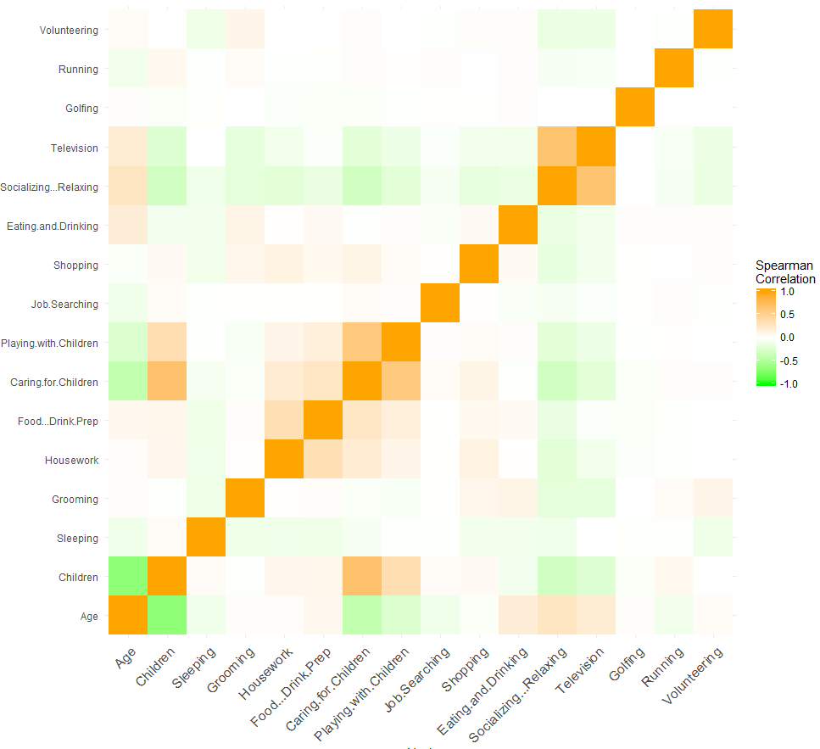
QUESTION 7 SIGNIFICANT VARIABLES Spearman Correlation
Point to Note:
Weekly Income and Weekly hours worked are outcomes of the Employment Status variable. Hence these variables are not taken into consideration for the modelling techniques.
Correlated variables:
Age and Number of Children
Playing with Children and Caring for Children
Television and Socializing
Notes:
Spearman correlation used as the variables are not normal

Slide 14
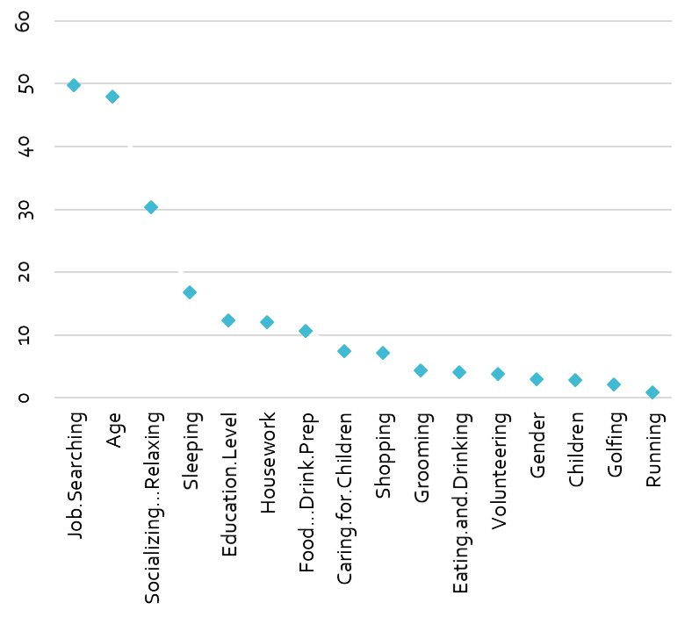
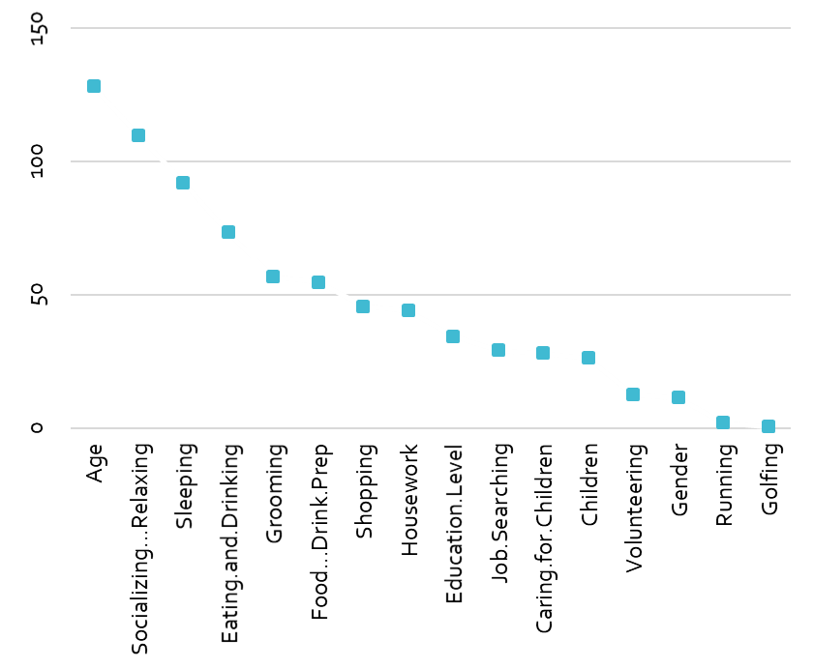
QUESTION 7 SIGNIFICANT VARIABLES Variable Importance Random Forest & Gradient Boosting
Point to Note:
Weekly Income and Weekly hours worked are outcomes of the Employment Status variable. Hence these variables are not taken into consideration for the modelling techniques.
Mean Decrease Accuracy- Random Forest
Mean Decrease Gini - Random Forest
Relative Importance – Gradient Boosting
Top 5 Significant Variables:
Age
Time spent for socializing
Time spent for Job Searching
Time spent for sleeping
Education Level
Notes: 75% validation train split made on the training dataset
Random forest and Gradient Boosting techniques used to arrive at the significant variables
Both yielded similar results

Slide 15
QUESTION 8 PREDICTION Confusion Matrix Random Forest & Gradient Boosting
Point to Note:
Weekly Income and Weekly hours worked are outcomes of the Employment Status variable. Hence these variables are not taken into consideration for the modelling techniques.
RANDOM FOREST
Accuracy
86%
Precision
20%
 | TRAIN |  | VALIDATION
 | Employed | Unemployed | Employed | Unemployed
Employed | 3% | 12% | 3% | 12%
Unemployed | 2% | 82% | 2% | 83%
GRADIENT BOOSTING
Accuracy
87%
Precision
28%
 | TRAIN |  | VALIDATION
 | Employed | Unemployed | Employed | Unemployed
Employed | 4% | 11% | 3% | 12%
Unemployed | 2% | 83% | 2% | 83%
Notes:
75% validation train split made on the training dataset
Random forest and Gradient Boosting techniques used to arrive at the significant variables

Slide 16
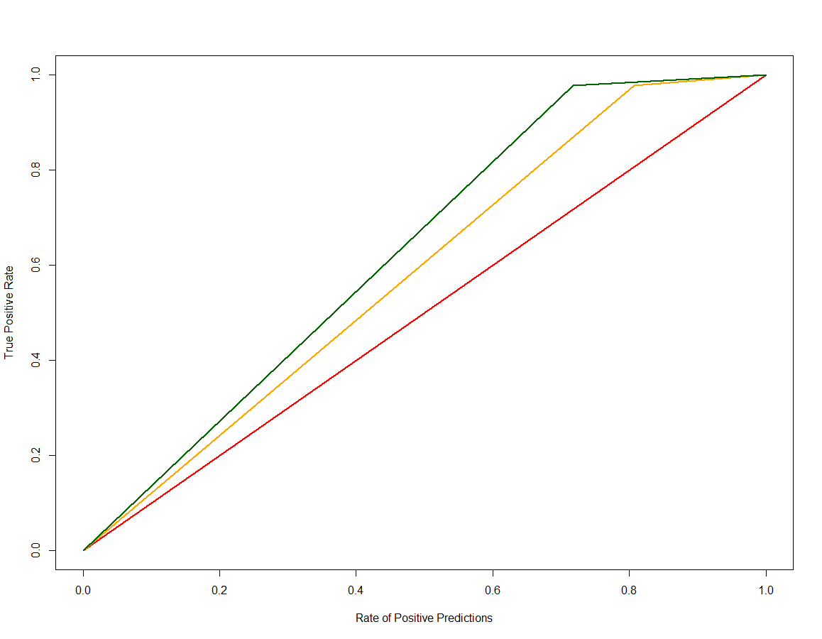
QUESTION 8 PREDICTION Gains Chart Random Forest & Gradient Boosting
Point to Note:
Weekly Income and Weekly hours worked are outcomes of the Employment Status variable. Hence these variables are not taken into consideration for the modelling techniques.
Baseline Model
Random Forest
Gradient Boosting
Notes:
75% validation train split made on the training dataset
Gradient Boosting chosen as the best modelling and used to predict the test

